Slide 1
Data Types

Slide 2
What is a data type?

Slide 3
A data type is a classification of a variable that indicates to the computer what the programmer wants to do with the data.

Slide 4
You’ve all seen and used these! int x; float average; String name;

Slide 5
Primitive Data Types are data types that are natively part of the CPU’s instruction set: byte int char float

Slide 6
When you write: int x = 6 + 2; The compiler will generate: add.l #2, #6, R0 int is native to the CPU

Slide 7
Similarly, char a = ‘A’; becomes move.b #65,R0

Slide 8
Composite Types

Slide 9
Composite types are types made up of one or more instances of one or more primitive types.

Slide 10
In Java, the most obvious example of a composite type is a class. In C, struct is a composite type.

Slide 11
A few that are, perhaps, a little more subtle: array union

Slide 12
Pointers and reference types

Slide 13
A pointer indicates an address, or a particular location in the computer’s memory. If this is unfamiliar, consider it like an address for a house. The address refers to the house, but it isn’t the SAME as the house.

Slide 14
Pointers are numbers, since the computer’s memory starts at 0 and goes to (however much memory the computer has).

Slide 15
NULL Pointers can point to a special value “NULL” - this means that there is no memory there. In terms of house addresses, you can think of it as “I don’t know”

Slide 16
You can do math on pointers to get new pointers! This is dangerous if you are not careful, since you may not have access to that memory.

Slide 17
References are an alias for another variable. They are often pointers, as well, but hidden by the compiler. They are often not re-assignable and must point to something. You can not do math on them.

Slide 18
Example in C: int j=0; int &a = j; // get a reference a = 1; // j is now 1 as well. int *x = &j; // x now points to j; *x is an int *x = 5; // j, a and *x are all now 5.

Slide 19
Abstract Data Types Data types that “hide” their internals and offer a defined set of operations

Slide 20
The most obvious Abstract Data Type that you have all worked with? Java classes

Slide 21
But ADTs can exist in other languages, even non-object oriented languages! For example, a linked list in C: typedef struct Node { void *data; // Remember void * points to anything struct Node *next; }

Slide 22
Generic Types Types that refer to other types

Slide 23
Example: List<string> x= new ArrayList<>();

Slide 24
Why is List<string> better than the Node with a void * that we saw in C?

Slide 25
Type Safety – the concept that the type system HELPS US to ensure that our programs are correct.

Slide 26
When we specify List<string>, we are creating a new type.

Slide 27
A “gotcha”
One thing that often confuses new developers:
int a[10]; // Makes 10 integers and calls them a
Student s[10]; // Makes 10 student references, all NULL.
When you make a collection of reference types, you must initialize them

Slide 28
Another “gotcha”
for (student s : students) {
if (s.semesterAverage >3) goodStudents.add(s);
s.semesterAverage = 0; // get ready for next semester
}
Hey – why do all of the good students have a 0 average?
When you hold a reference to an object, it isn’t a snapshot in time…

Slide 29
Function Types

Slide 30
A function type describes a variable that refers to a particular function

Slide 31
Function types enable the programmer to pass functions to other functions.

Slide 32
Example: In C, there is a sort implementation for QuickSort called “qsort”: void qsort (void* base, size_t num, size_t size, int (*comparator)(void*, void*)); Base points to the first item to sort num is the number of elements to sort size is the size of a single element comparator is a function that takes two void pointers and returns an int void pointer – a pointer to a memory address with no knowledge of the type of the thing at that address the int indicates if “thing 1” is less than (-1), equal to (0) or greater than (1) “thing 2”

Slide 33
This works for integers: int a[50]; populate(a); // do something to set values qsort(a,50,sizeof(int),comp); int comp(void *a, void *b) { int l = *(const int *)a; int r = *(const int *)b; if (l<r) return -1; if (l==r) return 0; return 1; }

Slide 34
And composite types: struct Student{ int age, grade; char name[20]; }; int comparator(const void *p, const void *q) { int l = ((struct Student *)p)-> grade; int r = ((struct Student *)q)-> grade; return (l - r); } students s[80]; qsort(s,80,sizeof(student),comparator);

Slide 35
Java added these in Java 8 Predicate<T> - takes a T and returns bool ex: Predicate<int> Positive = x -> x>0; Consumer<T> - takes a T and returns nothing ex: Consumer<int> Print = x -> system.out.print(x); Supplier<T> - takes no parameters and returns a T ex: Supplier<int> Ones = () -> 1; Function<T,R> - takes a T and returns an R ex: Function<int,int> Higher = x -> x+1;

Slide 36
Static Typing

Slide 37
Static Typing is what you know from Java – the process by which the compiler checks the type of your variables to ensure that the operation(s) that you invoke are valid.

Slide 38
Static typing is (for the most part) done in the compiler, assuming a compiled language. Once the type checking is complete, at compile time, the emitted code does NOT need to do type checking. There are cases where this is not so (casting, for example).

Slide 39
Dynamic Typing

Slide 40
If you are familiar with Python or JavaScript (or Scheme!) you may have noticed that those languages do not require you to declare types. These are dynamically typed languages.

Slide 41
Be careful – they are not untyped; the type work is done at runtime instead of compile time. Certainly for language implementations that are not compiled this makes sense.

Slide 42
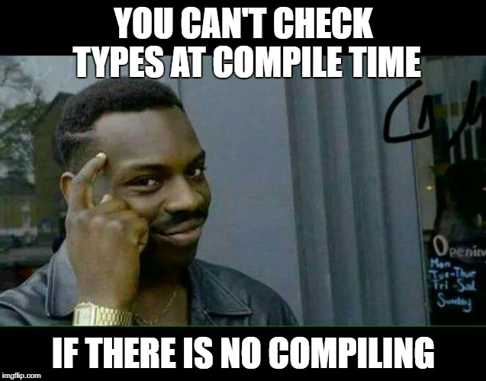

Slide 43
Duck Typing “If it walks like a duck and it quacks like a duck, it must be a duck.” Essentially, don’t worry about the type, just ensure that the methods that we call on the object actually exist.

Slide 44
Which one is “better”?
Static Typers argue:
Dynamic Typers argue:
Better documentation
Compiler catches errors before run
Compiled code runs faster
Compiler can optimize better with more information
Easier to reuse code
Less boilerplate
Compile/Interpret faster
I can write “eval”

Slide 45
My Take In a big codebase, I would rather have types to document what people expect in and out. They catch my stupid mistakes and make the code less likely to break at runtime. For a micro-project, it doesn’t matter.

Slide 46
Strong Typing vs Weak Typing

Slide 47
These terms lack strong definitions, unfortunately. Generally, though, a strongly typed language has strict type rules that are very hard to break. Java is a good example.

Slide 48
C is a good example of a weaker type system. While C has types, there are many, many ways to circumvent the system. char x[] = “aaaa”; int y = (int) x; float *z = (float *)y;

Slide 49
JavaScript is also weakly typed. It has a number of built-in conversions that change the type of a variable in what seem like odd ways. For example, in JavaScript, you can say: ‘Hello’ + 5 + ‘Goodbye’ and get Hello5Goodbye

Slide 50
Strong
Python
Java
Dynamic
Static
JavaScript
C/C++
Weak

Slide 51
Typing Roundup
Data Types describe “what” a variable is
Primitive are built in, function point to code, abstract hide data
Composite are collections of variables, pointers and references point to variables
Static Typing – compiler enforces type rules
Dynamic Typing – runtime enforces type rules
Strong Typing – enforcement is ironclad
Weak Typing – enforcement is more like a suggestion

